Slide 1
Unit 3 :
Physical Database Design
Databases
1

Slide 2
UNIT 3: PHYSICAL DESIGN OF DATABASES
Physical characteristics of database storage
Graphical tools for database implementation.
The data definition language.
Creation, modification and deletion of databases.
Type of data. Values. Operators
Table management
6.1 Syntax of the CREATE TABLE statement
6.2 Table properties
6.3 Modification of tables
6.4 Deleting tables
The data control language.
Views
Users and privileges
2

Slide 3
1. Physical design features
The physical design is carried out based on the logical design ( relational graph). It consists of all the SQL statements necessary to implement the database in the DBMS.
You have to create the tables by choosing an appropriate name. Table types and table constraints are established . (Default type MyISAM, also InnoD B for example. Sets where and how information is saved.)
For each table, the columns, their names and the data types they contain are defined.
The necessary restrictions are established on the table columns (PRIMARY KEY, NOT NULL, UNIQUE, FOREIGN KEY, etc.)
Views are created. (Virtual tables that simplify complex searches)
) , functions and triggers (objects that are activated when an action happens) are created .
Properties are set on the tables (storage engine, storage folder, autoincrement value, partitions, etc.)
3

Slide 4
2 Graphical tools for database implementation
Free graphics tools:
MySQL Workbench
phpMyAdmin (Requires Apache service with PHP engine)
HeidiSQL
MyDB Studio
4

Slide 5
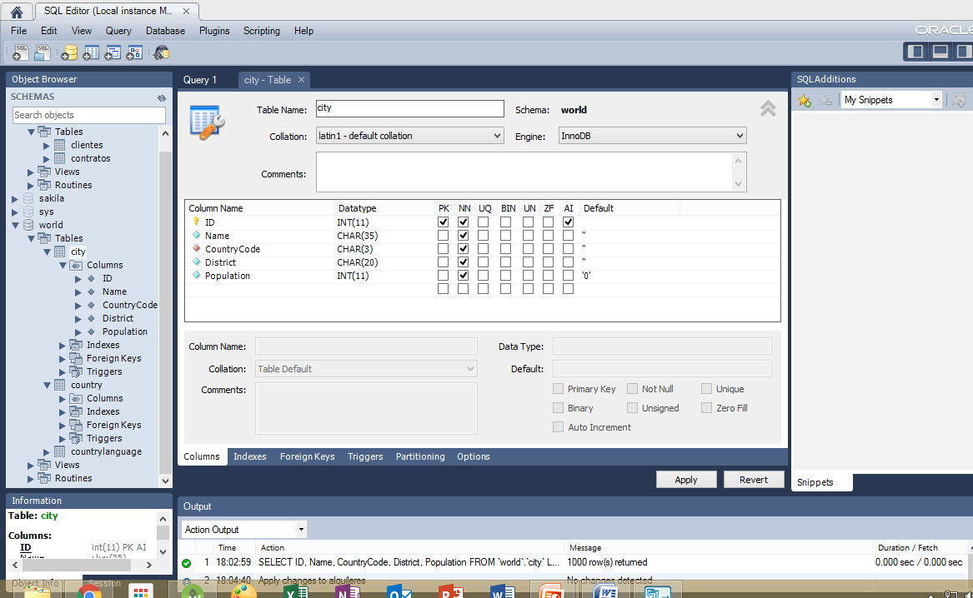
2 Graphical tools for database implementation
MySQL Workbench
5

Slide 6
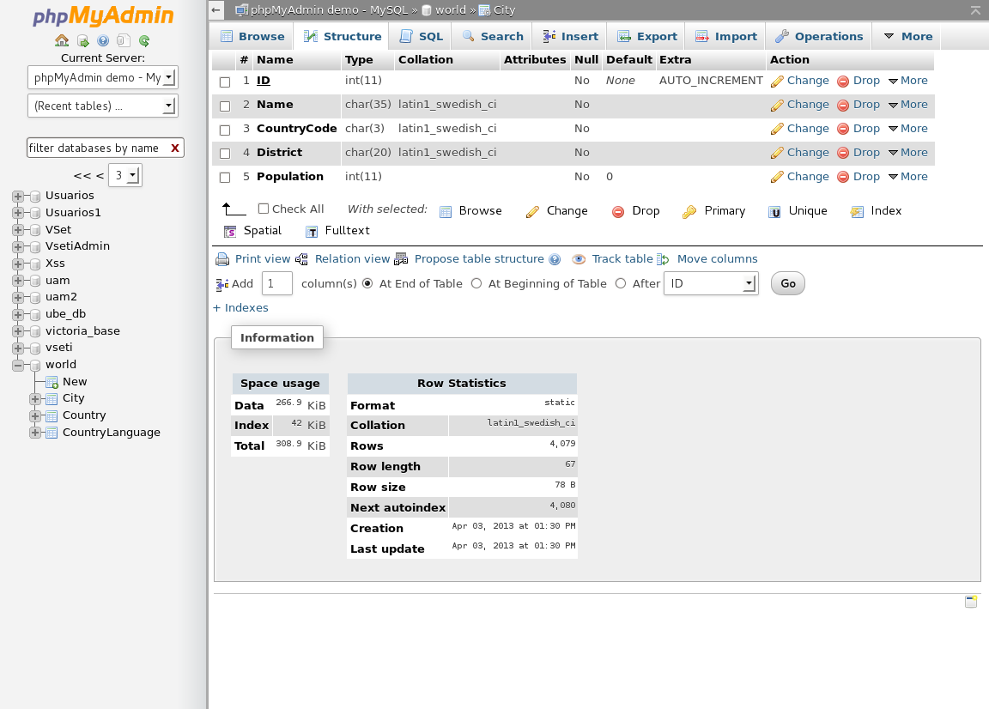
2 Graphical tools for database implementation
phpMyAdmin
6

Slide 7
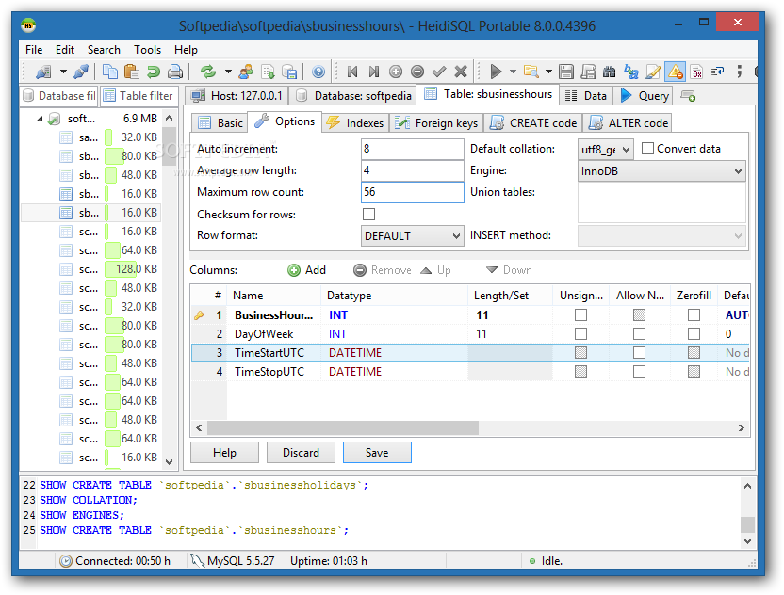
2 Graphical tools for database implementation
HeidiSQL
7

Slide 8
2 Graphical tools for database implementation
MySQL Workbench: Learning Exercise I
1.- Create an EmpTransportes database
2.- What is the SQL statement to create the database?
3.- Select the new database and identify the toolbar buttons to add tables, views and routines
8

Slide 9
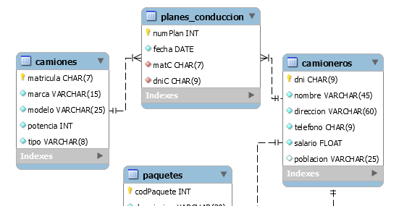
2 Graphical tools for database implementation
MySQL Workbench: Learning Exercise
4.- Graphically create the trucks table in the EmpTransportes database and copy the SQL statement to create the table.
9

Slide 10
2 Graphical tools for database implementation
MySQL Workbench: Learning Exercise
5.- Open a window to edit and execute SQL statements. Edit the statement to create the truckers table.
10

Slide 11
3 The data definition language
From this moment we started using the SQL language ( Structured Query Language).
It is a standardized language for interacting through queries on relational database systems. A query is understood as any request made to the DBMS.
Relational DBMSs always include some tool to execute SQL statements.
Since the first ANSI-SQL standard in 1986, several standards or versions of SQL have been developed. The latest is SQL-2011.
A standard establishes rules of syntax and operation of the repertoire of SQL statements.
11

Slide 12
3 The data definition language
SQL consists of a repertoire of instructions. In general, DBMSs include practically the entire repertoire of instructions of the SQL standard and with the same syntax. But it may happen that:
Do not include any instructions.
Include some of your own instructions that do not belong to the standard.
In some instructions the syntax may vary slightly due to not including some functionality or including some of its own functionality.
12

Slide 13
3 The data definition language
Interpreting the syntax of an SQL statement:
When we are given the full syntax of an SQL statement, for example, in the official MySQL documentation, we have something like this:
CREATE {DATABASE | SCHEMA} [IF NOT EXISTS] db_name [ create_specification ]
Create_specification : [DEFAULT] CHARACTER SET [=] charset_name | [DEFAULT] COLLATE [=] collation_name
We have to know how to interpret this to correctly construct the instructions.
13

Slide 14
3 The data definition language
Interpreting the syntax of an SQL statement:
Words in uppercase are SQL reserved words.
The words in lowercase and italics are replaceable parameters and whose value is decided by the user. Thus, for example db_name indicates that we have to write the name of the database.
Something in square brackets indicates that it is optional, meaning that we can write the statement without that part. If you write the optional, you do not have to write the brackets.
Something between braces indicates that we have to choose between one of the elements (separated by |) inside the braces.
Ellipsis indicates that we can enter a list of values of the above that there are.
14

Slide 15
3 The data definition language
Subsets of the SQL language
Depending on the type of operations performed, the SQL statement set can be considered divided into three subsets of statements.
DDL (Data Definition Language)
These are all the instructions that allow establishing the data structures in the databases. In short, they are the instructions to carry out the physical design of the databases.
DML (Data Manipulation Language)
They are the instructions that are used to manipulate the data stored in the databases (query, insert, modify, delete)
DCL (Data Control Language)
These are the data access control instructions (manage users and privileges, perform transactions, block, etc.)
15

Slide 16
3 The data definition language
Main instructions of the DDL language:
CREATE DATABASE
CREATE TABLE
CREATE INDEX
CREATE VIEW
CREATE PROCEDURE
CREATE FUNCTION
CREATE TRIGGER
ALTER (DATABASE, TABLE, VIEW, …)
DROP (DATABASE, TABLE, VIEW, ….)
16

Slide 17
4 Creation, modification and deletion of databases
Create a database. Syntax.
CREATE {DATABASE | SCHEMA} [IF NOT EXISTS] db_name [ create_specification ]
Create_specification : [DEFAULT] CHARACTER SET [=] charset_name | [DEFAULT] COLLATE [=] collation_name
In MySql it is the same to use DATABASE or SCHEMA .
IF NOT EXISTS clause causes no attempt to create the database if it exists. This way an execution error does not occur.
CHARACTER SET allows you to specify the character set or, in other words, how the characters are encoded internally (utf8, latin1, etc.)
COLLATION sets the criteria for sorting and comparing data alphabetically (for example, spanish_ci ).
Try to run this query indicating as ' my_database ' the database world ( check you have it or use any other ):
SELECT table_name,column_name,character_set_name,collation_name FROM information_schema.columns WHERE character_set_name !="NULL" AND table_schema =" my_database ”;

Slide 18
4 Creation, modification and deletion of databases
Example. Create an EmpTransportes database.
CREATE DATABASE EmpTransportes;
If we want the instruction not to fail if EmpTransportes exists:
CREATE DATABASE IF NOT EXISTS EmpTransportes;
If we want the database to be created to use the latin1 character set (instead of utf8 used by default) and with alphabetical sorting for Spanish (by default, general_ci is used):
CREATE DATABASE IF NOT EXISTS EmpTransportes CHARSET latin1 COLLATE latin1_spanish_ci;
18

Slide 19
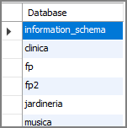
4 Creation, modification and deletion of databases
Show the databases mounted on the server.
SHOW DATABASES;
19

Slide 20
4 Creation, modification and deletion of databases
Modify a database
ALTER {DATABASE | SCHEMA} [ db_name] alter_specification;
alter_specification: [DEFAULT] CHARACTER SET [=] charset_name | [DEFAULT] COLLATE [=] collation_name
Delete a database
DROP {DATABASE | SCHEMA} [IF EXISTS] db_name;
Use a database
In order for us to execute instructions on an existing database, it is necessary to have it in use or open it:
USE db_name;
20

